Slide 1


AIBridge
Lecture 3
Notes:
Good afternoon everyone! Welcome to Lecture 4 of the series so far, my name is (name) and I’ll be primarily teaching the lecture today.
Hopefully you’ve gotten a good idea of how to use Python and how we manipulate data with some different Python libraries so far with our first three lectures.
Today, we’re going to start talking a bit more about what AI actually is and how we use the different types of AI to accomplish different tasks.

Slide 2
what is Artificial Intelligence?
Our first question:
Notes:
Our first question (click), of course, is (click) “what really is Artificial Intelligence”? (click)

Slide 3
Generally…
An AI is a fancy function that maps inputs to outputs.
input
special function
output
More generally, given a thing, AI can tell you a thing.
Notes:
At its simplest level, AI takes a series of inputs and runs it through a special function, giving you a relevant output.
The output could be anything, but it’s important that the AI algorithm itself is NOT explicitly coded to give you that information. (click)

Slide 4
AI Models
We call different types of AI functions models.
input
Model
output
4
Notes:
In the AI world, we call these different types of AI functions “models”. There are lots of different models that exist in the AI world, and they all work in different ways to make different predictions.
We’re going to explore a couple specific types of models today. (click)

Slide 5
AI Models
What are the inputs and outputs?
R_{n} to R_{m} functions
input
output
1
2
3
…
n
1
2
3
…
m
Model
Notes:
So what do we have to give the AI?
Usually, our inputs are a set of different pieces of information, represented by numbers: 1 through n here (point). We’ll talk a little more about how the numbers are encoded later on, but the important part is that the models prefer numeric inputs.
Similarly, the output will also be produced in a similar manner once the inputs are put through the model function: we have our m outputs here (point).
Because our model here takes n numbers and produces m outputs, we say that our model is an Rn to Rm function: it takes n real numbers and gives you back m real numbers. (click)

Slide 6
AI Model Examples
input
output
1
2
3
…
n
Model
m
A value!
Notes:
So let’s go over some examples!
Here, we can see an Rn to R1 function: the function takes n inputs and gives a single value as an output. (click)

Slide 7
AI Model Examples
input
output
1
2
3
…
n
0
“No”
Model
1
“Yes”
7
Notes:
This one is an Rn to R2 function, where the input is coded to a no value (point) and a yes value (point). (click)

Slide 8
AI Model Examples
input
output
cat
dog
rabbit!
tiger
chicken
8
Notes:
If we want to look at something a little more complex, we can take a look at something called “one-hot” categorical data:
This type of data is often used when we have a couple categories that are mutually exclusive. We’ll use 0 to represent something the input isn’t, and 1 to represent something the input is.
Using this method of encoding instead of using a single number, say, from 0-4, gives us a couple benefits:
Firstly, it gives us a bit more clarity on what category our data is actually in. If we were to use a scale from 0-4 for our data here, we would be making the (incorrect) claim that a rabbit is halfway between a cat and a chicken.
In a similar manner, if we wanted to make predictions and output in one-hot categorical form, something we’ll talk a bit more about in later lectures, we could actually make probabilistic predictions if we weren’t completely sure (e.g. 0.7 cat, 0.3 dog, etc.). (click)

Slide 9
AI Model Examples
input
output
“one-hot” categorical data!
not cat
0
0
1
0
0
1
2
3
…
m
not dog
Model
rabbit!
not tiger
not chicken
9
Notes:
If we want to look at something a little more complex, we can take a look at something called “one-hot” categorical data:
This type of data is often used when we have a couple categories that are mutually exclusive. We’ll use 0 to represent something the input isn’t, and 1 to represent something the input is.
Using this method of encoding instead of using a single number, say, from 0-4, gives us a couple benefits:
Firstly, it gives us a bit more clarity on what category our data is actually in. If we were to use a scale from 0-4 for our data here, we would be making the (incorrect) claim that a rabbit is halfway between a cat and a chicken.
In a similar manner, if we wanted to make predictions and output in one-hot categorical form, something we’ll talk a bit more about in later lectures, we could actually make probabilistic predictions if we weren’t completely sure (e.g. 0.7 cat, 0.3 dog, etc.). (click)

Slide 10
input
output
???
Model
???
by changing the shapes of input and output, models can represent a lot of different problems
Notes:
More generally, we can change the dimensions of our input and output in order to represent a lot of the different problems that AI can solve.
Essentially, this is the bigger idea behind the field of AI and machine learning.
TAKE QUESTIONS
At this point, we’re ready to explore something a bit more concrete. (click)

Slide 11
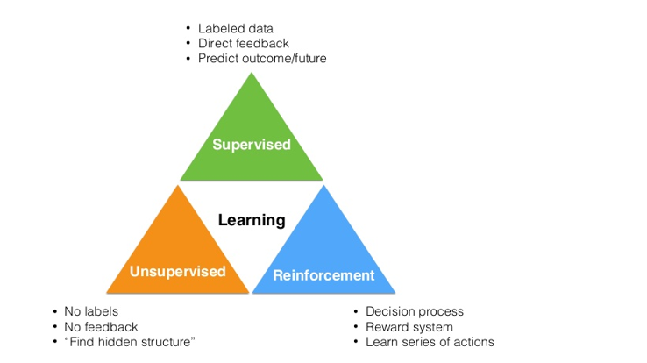
11
Notes:
If we want to look at something a little more complex, we can take a look at something called “one-hot” categorical data:
This type of data is often used when we have a couple categories that are mutually exclusive. We’ll use 0 to represent something the input isn’t, and 1 to represent something the input is.
Using this method of encoding instead of using a single number, say, from 0-4, gives us a couple benefits:
Firstly, it gives us a bit more clarity on what category our data is actually in. If we were to use a scale from 0-4 for our data here, we would be making the (incorrect) claim that a rabbit is halfway between a cat and a chicken.
In a similar manner, if we wanted to make predictions and output in one-hot categorical form, something we’ll talk a bit more about in later lectures, we could actually make probabilistic predictions if we weren’t completely sure (e.g. 0.7 cat, 0.3 dog, etc.). (click)

Slide 12
SUPERVISED LEARNING
Notes:
So let’s look at one specific type of AI algorithm: supervised learning algorithms. (click)

Slide 13
Supervised Learning
“Supervised learning (SL) is the machine learning task of learning a function that maps an input to an output based on example input-output pairs. It infers a function from labeled training data consisting of a set of training examples.” – Wikipedia
Input-output pairs: Features and labels
Training/learning and inference
Most widely used ML techniques in real-world applications.
Notes:
Overall, supervised learning models take data that is already labelled and prepared. The model will then use this data to learn specific relationships between the different data points.
At the moment, supervised learning is the most widely used machine learning technique in the real world because of its short-term feasibility and ease of implementation. Some people have said that over 95% of today’s applications are supervised learning! (click)
Explain more on the input-output pairs
Explain more on training/learning vs. inference
Image credit: What is Supervised Learning? | Concise Guide to Supervised Learning (educba.com)

Slide 14
Terminology alignment
Sample = (features, label)
Features: independent variables, attributes, predictors, input variables, input, covariates, explanatory variables, treatment variables,
Label: dependent variable, outcome, target variable, outcome variable, response variable
Samples: cases, observations, individuals, participants, data points
If you have other names for these, please let me know.

Slide 15
Supervised Learning
features
label
1
2
3
…
n
0
“No”
Model
1
“Yes”
15
Notes:
This one is an Rn to R2 function, where the input is coded to a no value (point) and a yes value (point). (click)

Slide 16
What types are there?
Notes:
So why is supervised learning so versatile? (click) What types of functions are there? (click)

Slide 17

Classification
Predicting a label/class/category
Ex: spam or not, cancer or not, cat or dog, red wine vs. white wine
Notes:
There are two main types of supervised learning functions that we’ll talk about today: classification and regression.
Classification is where you take in a set of inputs and you use them to predict discrete, categorical data.
Some examples here might be whether an email is spam or not, or, as you can see here (point at the image), whether it will be cold or hot tomorrow. (click)
Image credit: https://www.springboard.com/blog/data-science/regression-vs-classification/

Slide 18
What does classification do?
data
Model
category
18
Notes:
In terms of our model representation from before, classification takes in data and outputs the category the model thinks is most likely.
Once again, remember that classification is DISCRETE. (click)

Slide 19
Regression
Predicting a (continuous) quantity
Ex: Survival rate, wine quality, yield prediction
Notes:
Regression, on the other hand, predicts in a continuous manner.
Some examples here might be the quality of a specific type of wine on a scale, or, as you can see once again (point at the image), the temperature it will be tomorrow. (click)

Slide 20
What does regression do?
data
Model
Cont. value
Notes:
Most regression models, therefore, take in a piece of data and use the model to generate a value on a continuous scale. (click)

Slide 21
Examples
You’re running a company, and you want to develop learning algorithms to address each of two problems.
Problem 1: You have a large inventory of identical items. You want to predict how many of these items will sell over the next 3 months.
Problem 2: You’d like software to examine individual customer accounts, and for each account decide if it has been hacked/compromised.
Are they classification or regression?
Notes:
For the first set of problems, let’s pretend that you’re running a company and you want to develop ML algorithms for each of these following two problems.
Do we want to use a classification or a regression model for each?
HOLD FOR STUDENT ANSWERS

Slide 22
Supervised Algorithms Practice
You’re running a company, and you want to develop learning algorithms to address each of two problems.
Problem 1: You have a large inventory of identical items. You want to predict how many of these items will sell over the next 3 months.
Can we formulate it as a classification problem?
Notes:
Nice! And one more, if we want to turn this particular problem here (point) into a classification problem, can we do that?
HOLD FOR STUDENT ANSWER
Well, we could classify whether each specific item has sold. But that would take a lot of computation and it wouldn’t be very efficient. (click)

Slide 23
Supervised Algorithms Practice
You’re running a company, and you want to develop learning algorithms to address each of two problems.
Problem 1: You have a large inventory of identical items. You want to predict how many of these items will sell over the next 3 months.
Can we formulate it as a classification problem?
We could. Sometimes, we can reformulate.
Let’s start with regression instead!
Notes:
So instead, we want to use a regression to predict how many sales we’re going to make! (click)
TAKE QUESTIONS
OK, so we’ve got a good idea of how machine learning works, so let’s take a look at the dataset we’re going to use to explore these algorithms. (click)

Slide 24
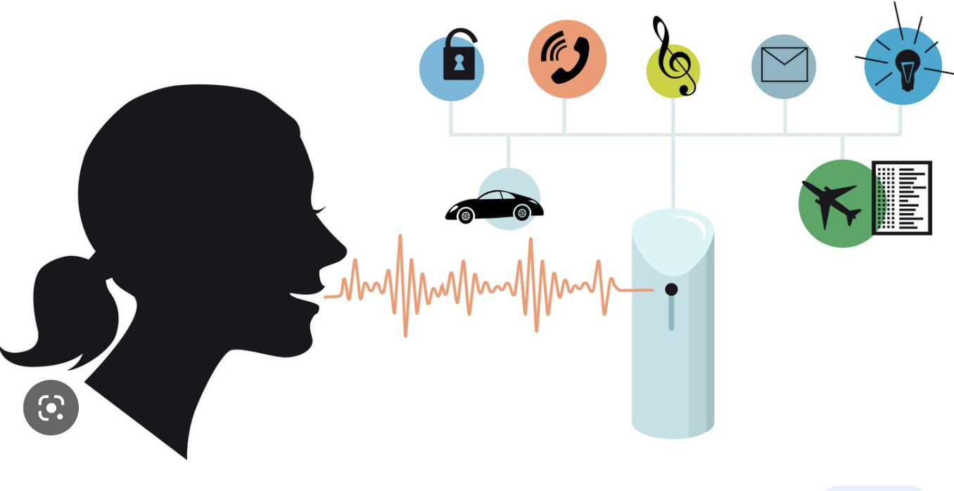
Speech Recognition
Notes:
Speech recognition is the task of transcribing spoken words into text. This is a classification task because the system needs to classify different words or phrases based on their acoustic features such as pitch, duration, and frequency. Speech recognition is used in virtual assistants, call centers, and dictation software

Slide 25

Face Recognition
Notes:
Face recognition is the task of identifying or verifying an individual's identity based on their facial features. This is a classification task because the system needs to classify different faces into different categories based on their unique features. Face recognition is used in security systems, mobile phones, and social media platforms.

Slide 26
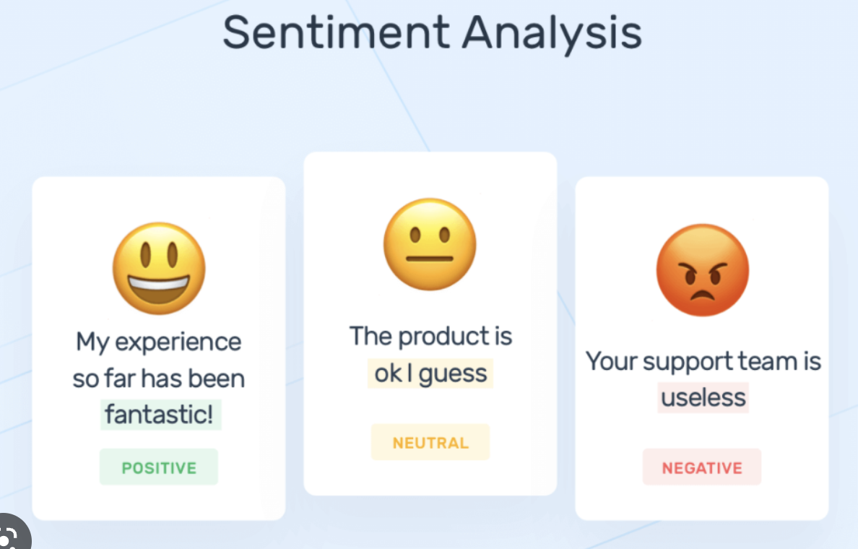
Sentiment Analysis
Notes:
Classifying the sentiment of text data as positive, negative, or neutral. For example, analyzing customer reviews of a product or service. This is a hard problem, results are not as good as many other applications. Due to the complexity of human language, expression.
n general, sentiment analysis systems can accurately identify the overall sentiment of a text as positive, negative, or neutral, but they may struggle with more nuanced emotions or sarcasm. They also have difficulty with text that is written in multiple languages or contains slang, idioms, or other forms of non-standard language.
One of the main challenges in sentiment analysis is dealing with the context of the text. For example, the word "sick" can have a positive connotation in some contexts (e.g. "That skateboard trick was sick!"), while it has a negative connotation in others (e.g. "I feel sick"). Therefore, sentiment analysis systems need to take into account the surrounding words and the broader context to accurately identify the sentiment.
Despite these challenges, sentiment analysis systems have many practical applications, such as monitoring customer feedback, tracking brand reputation, and analyzing social media trends. As the technology continues to improve, sentiment analysis is likely to become even more accurate and effective.

Slide 27

Spam Filter
Notes:
Classifying emails as spam or non-spam based on the content, sender, subject line, and other attributes.

Slide 28

Fraud Detection
Notes:
Classifying credit card transactions as fraudulent or legitimate based on patterns in the data such as location, amount, and time of day, type of purchase, etc. One challenging problem here is false positive. For example, your bank declines your purchase and asks you to verify it. SF shopping trip. This is why your bank may ask you to register foreign travels to avoid such problems.

Slide 29
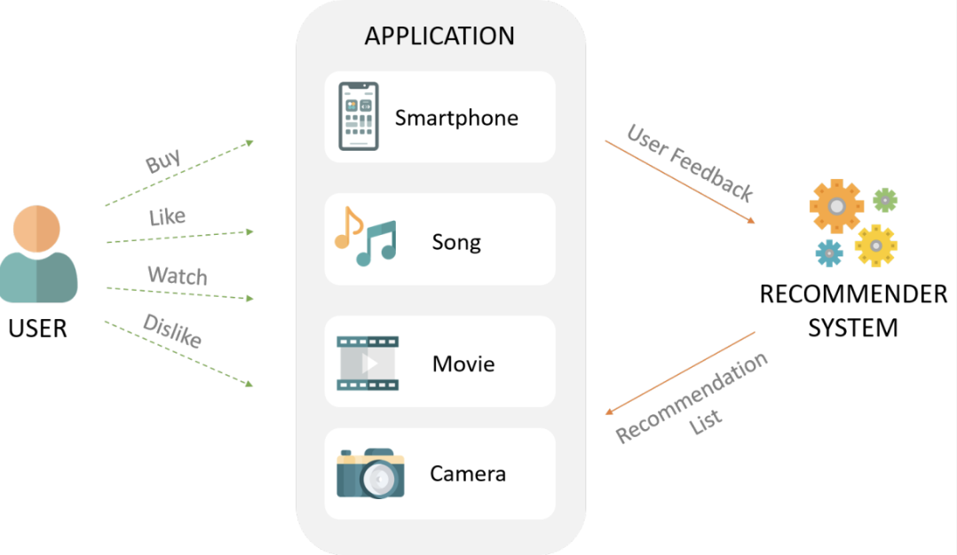
Recommendation
Notes:
Recommendation systems are used to recommend personalized content or products to users based on their preferences, interests, and behavior. This is a classification task because the system needs to classify users into different categories based on their attributes and behaviors. Recommendation systems are used in e-commerce websites, music and video streaming platforms, and social media networks. The more feedback/lables you give to the system, the better the performance will be.

Slide 30
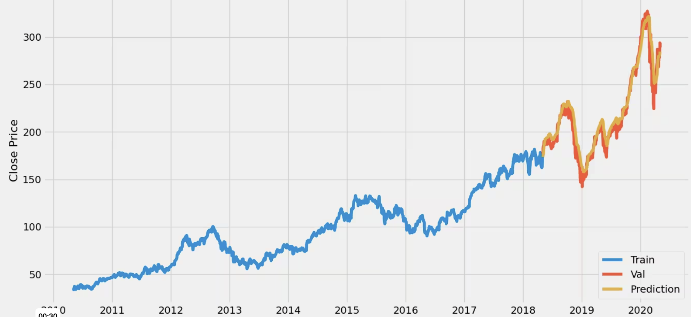
Stock Price Prediction

Slide 31
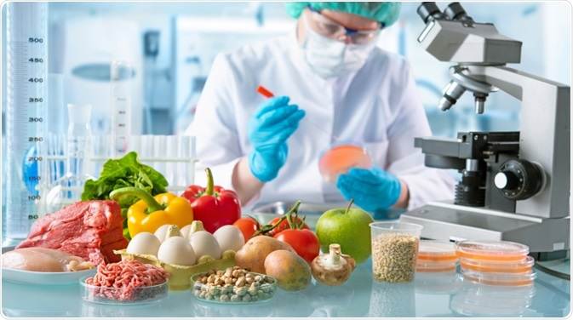
Food Quality/Safety Prediction
Notes:
For instance, ML regression models can be trained on large datasets containing information about the composition and sensory profiles of different food products. These models can learn the relationships between input features (such as ingredient proportions, processing conditions, and storage conditions) and the sensory attributes or quality scores assigned by human experts.
Once trained, the ML model can be used to predict the quality or sensory attributes of new food products based on their input features. This can be particularly useful in the food industry for quality control, product development, and optimization of formulations and processing parameters.
Another application of ML in food science is in the field of food safety. ML algorithms can analyze data from various sources, including foodborne illness reports, ingredient and process data, and environmental conditions, to identify patterns and risk factors associated with food contamination or outbreaks. This information can help food safety professionals to implement preventive measures, improve inspection strategies, and enhance overall food safety protocols.
Overall, ML techniques offer

Slide 32
“All models are wrong, some are useful” - George Box
Notes:
we should focus more on whether something can be applied to everyday life in a useful manner rather than debating endlessly if an answer is correct in all cases. We are going to learning a number of ML algorithms in this class. Keep in mind what assumptions they are making, what problems they try to solve. Not a single algorithm beats all others. Now, let'

Slide 33
Our dataset: wine quality
Notes:
So now that we have a bit of a better idea in regards to machine learning as a whole (thank you Prof. Liu for the introduction!), we’re going to turn to something a bit more concrete and examine our dataset a bit more closely. Today, our examples are going to be based on the wine dataset that you’ve been working with in your lecture exercises. If we take a look at the dataset description, **(slide)**

Slide 34
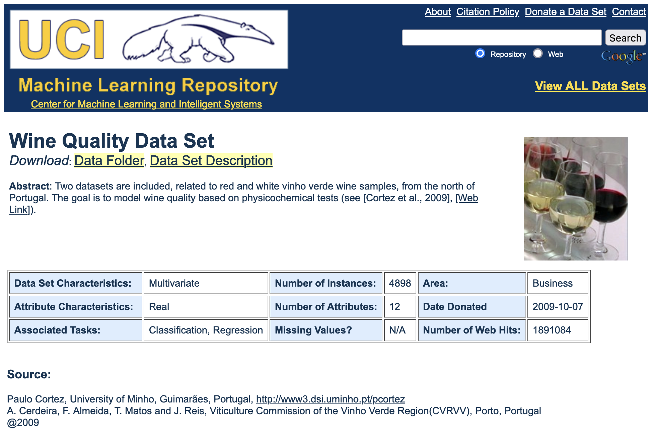
Wow! 12 attributes!
(and quality, which can be counted as a 13th)
What does our dataset look like?
Notes:
Right away, when we look at this page, we see that there are 12 attributes in this dataset. I’m sure you’ve seen when you’ve been working with the wine dataset yourself, but this means that in order to describe each wine, we have 12 different data points + the quality, so we’re going to have a lot of data to manage if we want to build effective models. **(slide)**

Slide 35
Structuring our dataset
Fixed acidity
Volatile acidity
Citric acid
Residual sugar
Chlorides
Free sulfur dioxide
Total sulfur dioxide
Density
pH
Sulphates
Alcohol
White/Red
a feature of input data
a sample is a collection of features
35
Notes:
Let’s look at each of the 12 separate attributes here. We can see that we have (list out the attributes) here, and we’re going to call each of these attributes **(click)** features of our data. The collection of features that we choose to work with is called a **(click)** sample.
Here, our sample has 12 features, meaning we have 12 columns total in our dataset. When we take each specific wine datapoint, we’re grabbing a specific numeric value from each of the 12 columns, and in that sense we can represent these datapoints with a 12-dimensional vector that we input into the models we want to use. We represent vectors with this **(click)** square bracket notation here. **(slide)**

Slide 36

So if we want to predict wine quality…
Fixed acidity
Volatile acidity
Citric acid
Residual sugar
Chlorides
Free sulfur dioxide
Total sulfur dioxide
Density
pH
Sulphates
Alcohol
White/Red
Quality (0-10)
Notes:
Our premise here is essentially that we want to use our 12 features in order to predict the wine quality, and we’re going to do this by taking the different data points, crunching some numbers, and then rating the wine quality
as a number between 0 and 10. How can we do that? Well… (click)

Slide 37
…we’ll need a model!
Fixed acidity
Volatile acidity
Citric acid
Residual sugar
Chlorides
Free sulfur dioxide
Total sulfur dioxide
Density
pH
Sulphates
Alcohol
White/Red
Model
Quality (0-10)
Notes:
Let’s use an AI model!
And really quickly, do we want to use classification or regression?
HOLD FOR STUDENT ANSWER: regression
Mhm, yep! In fact, there’s a specific type of regression that we want to use here, known as… (click)

Slide 38
Linear Regression
Notes:
Linear regression **(slide)**

Slide 39
Linear Regression
What does linear regression represent? The features vs. The label
Fixed acidity
Volatile acidity
Citric acid
Residual sugar
Chlorides
Free sulfur dioxide
Total sulfur dioxide
Density
pH
Sulphates
Alcohol
White/Red
Quality (0-10)
Notes:
Linear regression is a simple way to represent a specific relationship between the **(click)** input features, and the **(click)** label, the output feature. In our case, our input features are the 12 features listed here **(point)** and our output feature that we want to predict is the quality of the wine on a scale from 0-10 **(point)**. Overall, the general goal for linear regression is to get as close as we can to finding the true relationship between the input features and the output feature. **(slide)**

Slide 40
Let’s start with one variable.
Notes:
Let’s start by looking at a very simple form of linear regression: just using one variable to predict another. Some examples of this might include using someone's height to predict their weight, or, in our case, **(slide)**

Slide 41
Linear Regression
We’ll just consider one feature of our sample.
Acidity
Model
Quality (0-10)
Notes:
using the acidity of a wine to predict its quality. **(slide)**

Slide 42
Linear Regression
Quality
Output
Acidity
Input
Notes:
If we take a look at our plot here, we can see that when we plot a couple points in our dataset, we get this result **(point)**. At a glance, we can see a roughly linear relationship between **(click)** the input, acidity, and **(click)** the output, quality. Indeed, as its name suggests, linear regression looks for the line that best represents the relationship between the inputs and the outputs, which are placed on the x- **(point)** and y-**(point)** axes respectively. **(slide)**
DEMO: Draw a rough approximation of this dataset and have people volunteer to draw lines of best fit. Ask everyone to do the consensus voting thing (“yay” “nay”). After a couple, introduce your own lines of best fit as well and move on.

Slide 43

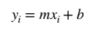

Linear Regression
Quality
Prediction
“slope” (rotation of the line)
Acidity
“intercept” (shift of the line)
Notes:
Our next step, then, would be to generate the **(click)** actual line that makes the predictions. You might remember that the equation of a line is **(click)** y = mx + b from past math classes. In the context of a linear regression, the **(click)** slope **m** will indicate how the prediction changes with each unit increase in the input feature, while **(click)** the y-intercept **b** is the value of the output when we receive an input of 0. In that sense, our task is to find the optimal values of **m** and **b** in order to most accurately generate an output for a random new input. Each line we draw is known as a **(click)** prediction, and we want to use these different predictions to best fit our existing sample from the dataset.
We can look at a couple examples of different values of **m** and **b** that make a couple different lines. **(slide)**

Slide 44
Linear Regression
Quality
Acidity
Notes:
This second line is, frankly, pretty bad at predicting for our dataset here. It’s pretty obvious that the trend the line describes is completely opposite to the trend our dataset has. And then lastly, **(slide)**

Slide 45
Linear Regression
Quality
Acidity
Notes:
this third line is sort of in the middle: it predicts overall pretty well, but at each end again there are some pretty big differences between what it predicts and what the dataset says. Overall, however, we've been talking about the correctness of a line's predictions in pretty abstract terms. **(slide)**

Slide 46
How do we evaluate these models objectively?
Notes:
So how can we introduce a metric that can quickly and easily be computed in order to determine once and for all how good a line is at making predictions? This is where we need to introduce the concept of error. **(slide)**

Slide 47

Calculating Error
error is a measure of the “incorrectness” of a line
Quality
error
Acidity
Notes:
The error of a line is the measure of how "incorrect" its predictions are, and there are a variety of ways to calculate this "incorrectness".**(slide)**

Slide 48
Calculating Error
simple error: difference between the predicted value and the actual value
Quality
error
Acidity
Notes:
One way is to take each data point in the dataset and compare its value to the value that our line predicts. The error is simply the difference between the predicted value and the actual value. This type of error calculation does its job, but there are a couple pertinent issues with this type of error calculation. Most importantly, we might want to penalize the line more if it has a very large error with a specific point, which is something that doesn’t show up well when we simply sum the errors. In order to rectify these issues, **(slide)**

Slide 49
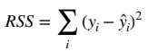
Calculating Error
sum-of-squares error: sum of the squared difference between predicted and actual values
Quality
squared error
Acidity
Notes:
we use a slightly modified version of error calculation known as sum-of-least-squares. In sum-of-least squares, we look at the *square* of the difference between the predicted and actual values. This solves the problem of weighting by magnifying larger errors while also keeping the error calculation relatively simple.
Naturally, we want to minimise the least-squared error that we calculated in this last step. To do so, we need to minimise the sum of the squared differences that we just calculated, and we would do so using **(slide)**

Slide 50
Calculating Error
How do we minimize error? Cost function
Sum of all of the squared differences
Square it!
-1
Difference between predicted and actual
Divide by number of samples: mean error, not total error
50
Notes:
this cost function. Though this cost function seems relatively complicated, we can break it down a bit. Inside the parentheses, we have **(click)** the difference between the predicted and actual values, which we **(click)** square. Note that we have a special notation, known as “y-hat”, to represent the predicted value, while we use y to represent the actual output value.
After we calculate this difference, we then take **(click)** the sum of this squared difference across all of the predictions we make, and then **(click)** divide by the number of samples in the dataset in order to find the average of the error. We don't want to look at the error for all of our predictions when we make a single prediction, as this would grossly overcorrect. Once we get our error with this formula however, it is relatively easy to adjust our original prediction line to minimize the error that we just calculated with this cost function. More generally, the process of minimizing cost is a bit more iterative and it’s known as gradient descent; however, we don’t need to worry about this process at all or gradient descent at all. **(slide)**

Slide 51

Calculating Error
Minimising cost by using gradient descent
51
Notes:
DEMO: blindfold two TAs, have two volunteers pair off. I will hold a candy bar or something delectable in my hand, and it’s the job of the volunteers to direct the TAs one step at a time toward the candy. Whoever gets there first wins. Make sure they all start from different locations and give different directions.
This is the principle of gradient descent! Go step-by-step and track towards the minimum possible cost.

Slide 52

Higher-dimensional linear regression
So what about the main dataset? And its 12 features?
Notes:
Now that we have a basic understanding for linear regression, we can take it a bit further and go back to looking at our full dataset. **(slide)**

Slide 53
Higher-dimensional linear regression
Fixed acidity
Volatile acidity
Citric acid
Residual sugar
Chlorides
Free sulfur dioxide
Total sulfur dioxide
Density
pH
Sulphates
Alcohol
White/Red
Linear Regression
Quality (0-10)
Notes:
Once again, we can see that we have 12 features instead of just 1, which means that we're going to be plotting in 12 dimensions instead of 1! Though it is impossible to plot in a powerpoint, we can use something known as **(slide)**

Slide 54
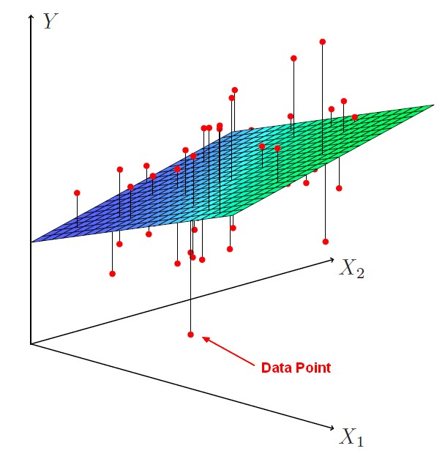
Higher-dimensional linear regression
Hyperplanes!
More dimensions, similar math.
Notes:
a hyperplane that makes use of all 12 of these features in order to plot a 12-dimensional line to best predict the quality. The equation of the hyperplane is included here **(point)**, and we can see that our original linear equation, **y = mx + b**, is just a special case of this equation where we only have one variable. Despite the fact that we're now using 12 dimensions instead of 1, the goal remains the same: we want to find the best-fitting hyperplane that minimises the squared difference between the predicted and actual values. **(slide)**

Slide 55
One key assumption we make
dataset linearity
Notes:
Linear regression, especially forms of linear regression with more features, makes one key assumption about how the dataset is structured: the dataset is linear, that is, that the relationship between our features and our labels can be represented by a line.
TAKE QUESTIONS **(slide)**

Slide 56
What if our data doesn’t have a linear representation?
Notes:
It's pretty obvious that not all data is going to fit a linear model, and that our first assumption isn't going to hold true for these datasets. So what happens then? For example, what if we have a dataset like **(slide)**

Slide 57
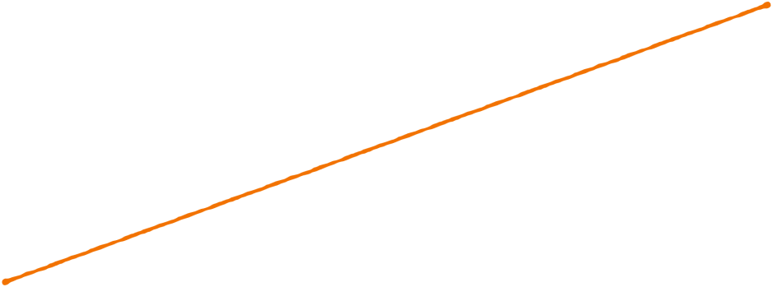

The assumption fails…
This model isn’t great…
model is unable to capture relationship between variables
Notes:
this, where a linear model doesn’t work very well? Clearly, even by just an eye test, we can tell that especially on this right side **(point)** we're going to have extremely large amounts of error. So what can we do? What happens when our data doesn't have a linear representation? **(slide)**

Slide 58
We need to make our model more powerful!
Notes:
We need to make our model more powerful! Specifically, in the context of a linear regression function, we need to add terms that make it capable of adapting to more complex shapes that aren't just lines. This is known as **(slide)**

Slide 59
Polynomial Regression
Notes:
**polynomial regression**. Polynomial regression derives from linear regression in that it maintains the basic model of predicting using a function. However, instead of using just a line, **(slide)**

Slide 60
Polynomial Regression
introducing higher-dimensional terms to add curvature
nth degree term
nth term coefficient
Notes:
we introduce a couple higher-degree polynomial terms in order to fit a curve to the data. The equation thus becomes something like the one you see here, where we have a coefficient of **(click)** w_n for the **(click)** nth degree term of x. Note once again that we’re representing the whole equation with “y-hat”, which denotes that this is a predicted output and not an actual one. **(slide)**

Slide 61
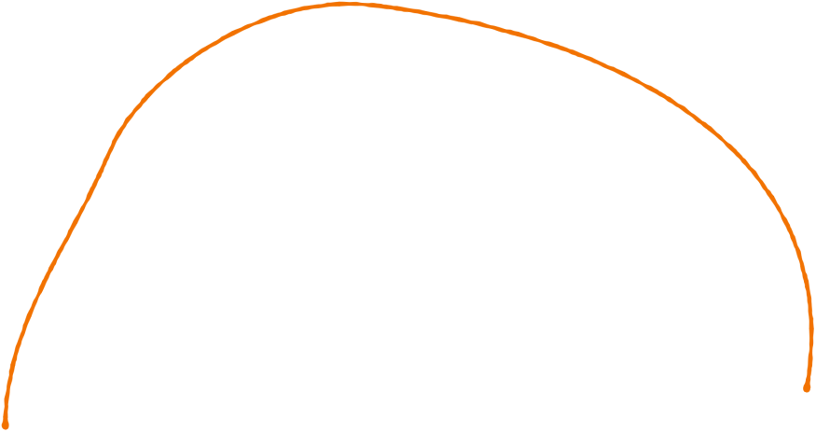
Polynomial Regression
Better…
Notes:
We can see a couple examples of polynomial regression here. This first curve is a degree two curve, a parabola. Clearly, it does a significantly better job than a linear model in predicting for this dataset. Another curve we can use is **(slide)**

Slide 62

Polynomial Regression
What about this?
Notes:
this one, a degree six curve. At a glance, it seems like this degree six curve does a significantly better job at predicting than the degree two curve would. However, we can see that if we add a data point like **(slide)**

Slide 63
Polynomial Regression
What about this?
Notes:
this one that only loosely follows the same general trend as our previous data points, **(slide)**

Slide 64
Polynomial regression - Which one is better?
Notes:
It becomes a harder to distinguish which model is actually better.
Let’s take a quick straw poll: if you think the left one is better, raise your hand: (hold for count). Alright, you can lower your hands now. And if you think the right one is better, raise your hand now: (hold for count).
(funny quip about results)
In reality,

Slide 65
Polynomial Regression
A significant difference!
Notes:
the error with the degree six curve would be a lot greater than if we introduced this same point to the degree two curve. This issue is known as **(click)**

Slide 66
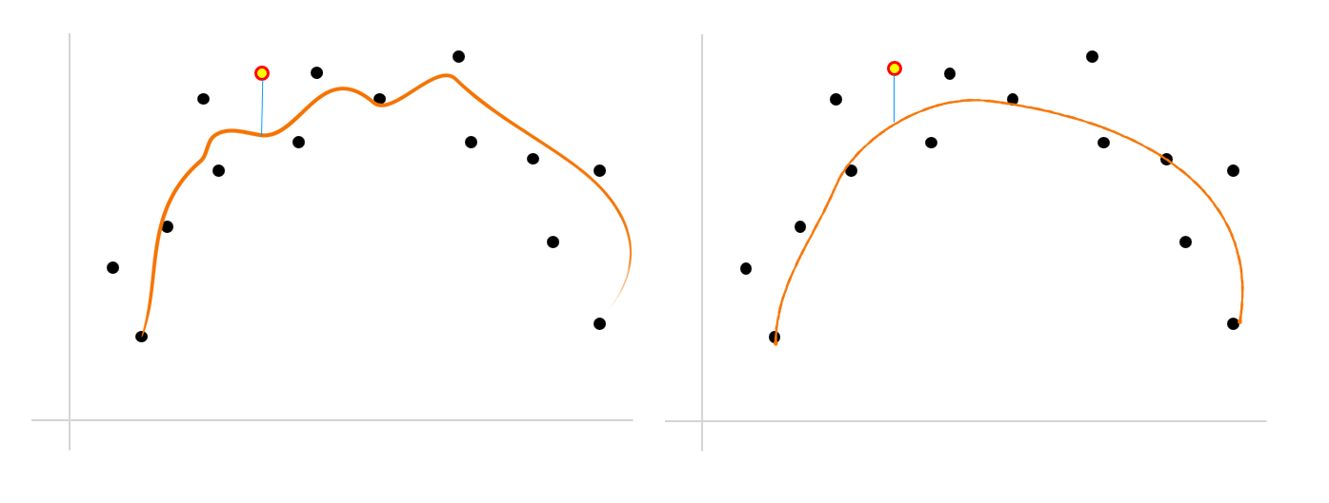
Polynomial Regression
We overfit the dataset…
Notes:
**overfitting**, and we'll talk a bit more about this in the coming lectures. For now, just remember that a higher degree doesn't necessarily mean a better prediction.
Anyway, we’ll want to optimize our polynomial regression to get to this point as well, and in fact we use a very similar method as we did with linear regression: **(slide)**

Slide 67
Calculating Error
The same cost function!
Sum of all of the squared differences
Square it!
-1
Difference between predicted and actual
Divide by number of samples: mean error, not total error
67
Notes:
we simply take the sum of the squared differences between our predicted values and the actual values, then find the average and use this to modify our polynomial regression model to better fit the dataset. The cost function, therefore, is also the same as linear regression, where we look at the squared difference between y-hat, the predicted value, and y, the actual value. In a very similar fashion as we did for linear regression, we can explore how polynomial regression can be used on higher-dimensional data as well. **(slide)**

Slide 68
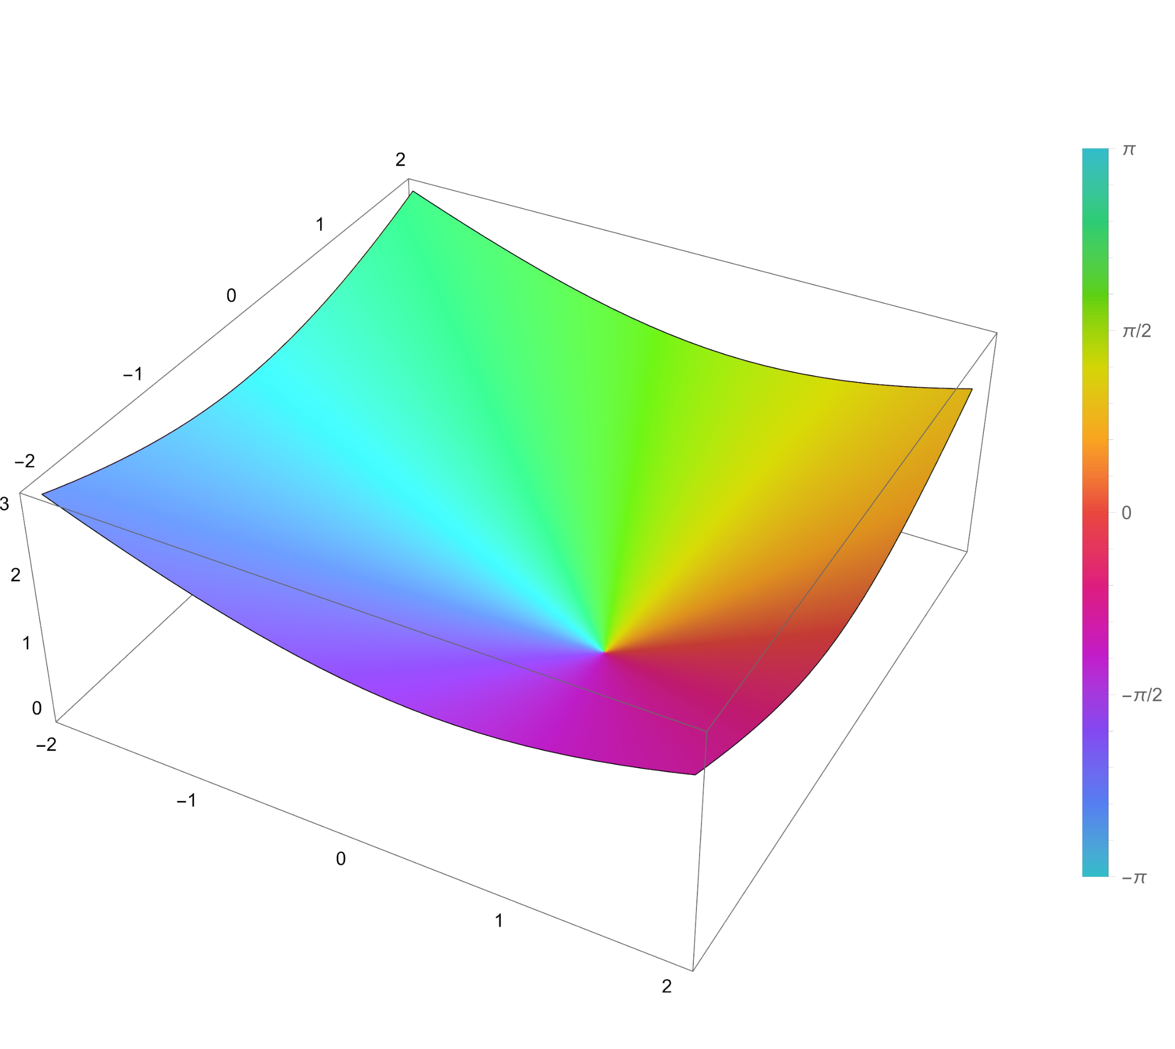
Higher-dimensional polynomial regression
More powerful (and complex) models!
Notes:
The prediction models that are generated by these higher-dimensional polynomial regressions are much more complicated than a hyperplane as you can see here, but generally take the form of this curved surface in high dimensions. When we examine the **(slide)**

Slide 69
Higher-dimensional polynomial regression
More powerful (and complex) models!
Notes:
general equation for polynomial as well, we can see that different features can have different exponents, further changing how our prediction model looks. In addition to that, there are also terms known as “cross-feature terms” like **(point)** this one, where we have multiple features multiplying together into one term. Note as well, one more time, the use of y-hat to represent the fact that this is a prediction. Overall, we can see that there are a lot of different ways for us to represent different polynomial regressions both in polynomial form and in graph form as we saw on the last slide, and these shapes may in general be pretty hard to represent and imagine. At the same time, the implementation of the math behind higher-dimensional data stays the same: **(slide)**

Slide 70
Higher-dimensional polynomial regression
Don’t worry, the math stays the same:
Build a polynomial regression model
Evaluate the cost function
Minimize the cost function and optimize our model
Notes:
we build a polynomial regression model based on our data, evaluate it with our cost function, and minimise the cost over multiple iterations as we see fit. **(slide)**
TAKE QUESTIONS/POTENTIAL BREAK POINT

Slide 71
What about classification?
Notes:
Both linear and polynomial regression are primarily focused on using regression in order to predict across their data. As we saw, both models took in the 12 features from the wine dataset in order to output a quality score on a continuous scale from 0-10. But **(click)** what if we wanted to classify the wine, say as a white or a red wine? What would we use then? **(slide)**

Slide 72
LOGISTIC REGRESSION
Notes:
In this case, we would use something known as logistic regression. **(slide)**

Slide 73
Logistic Regression
Fixed acidity
Volatile acidity
Citric acid
Residual sugar
Chlorides
Free sulfur dioxide
Total sulfur dioxide
Density
pH
Sulphates
Alcohol
a class
0
1
categorical label outputs are named “classes”
Notes:
Logistic regression is a classification algorithm that takes input features just like linear and polynomial regression does, but predicts discretely in two classes, represented as a 0 or a 1. Because we want to predict either for a red or a white wine, **(slide)**

Slide 74
Logistic Regression
White = 0
Red = 1
Notes:
we'll call the red wines 1 and the white wines 0 for now. This causes an interesting question to arise: **(slide)**

Slide 75
Why can’t we just use linear or polynomial regression?
Notes:
if we're encoding our classes as numbers anyway, why wouldn't we use linear or polynomial regression to make these predictions? It's mainly because fitting a line to this dataset would look something like **(slide)**

Slide 76
Logistic Regression
Red
not super great
White
Acidity
Notes:
this, where we have a large range of values that simply wouldn't fall under either of the two classes. For example, we could have this point **(slide)**

Slide 77
Logistic Regression
Red
0.5
White
Acidity
Notes:
here at 0.5, which is precisely in between the two classes. We could have this point **(slide)**

Slide 78
Logistic Regression
2
Red
White
Acidity
Notes:
here at 2, which actually exceeds the two classes. Or we could have this point **(slide)**

Slide 79
Logistic Regression
Red
White
Acidity
-1
Notes:
here at -1, which again doesn't fall under either class. In essence, we need to create a function that is **(slide)**

Slide 80
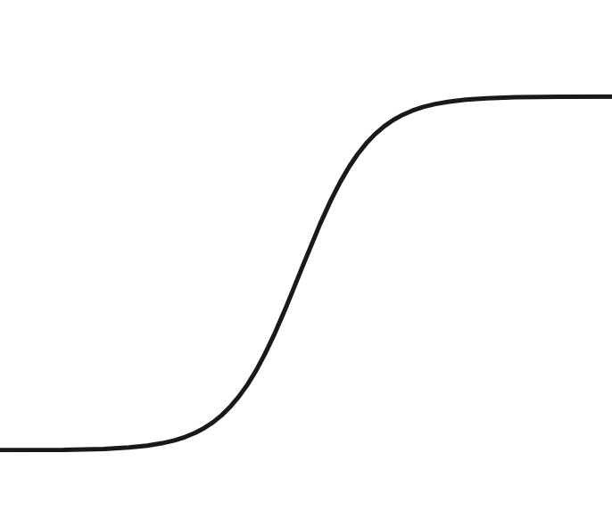
Logistic Regression
Red
logistic functions!
White
Acidity
Notes:
relatively flat at both ends (these are where the classes usually are) but is also relatively steep in the middle (this is the gray area in between the classes). This shape almost perfectly describes the **(click)** logistic, or sigmoid, function, and indeed that's why this type of algorithm is called logistic regression. The general equation for logistic regression is represented **(slide)**

Slide 81
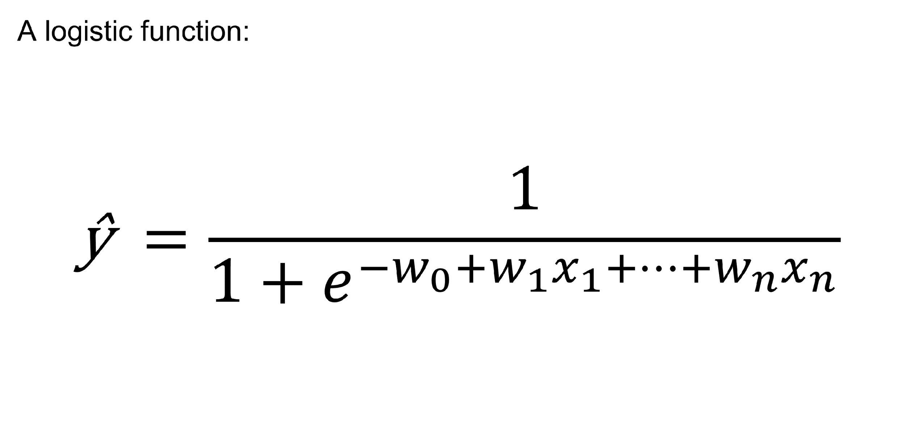
Logistic Regression
our input features are here
Notes:
here. It's quite a bit different than our other two regressions, and the reason is because its shape is significantly different as well. However, it maintains a couple things from the other functions. Firstly, we see y-hat, which represents our prediction. As well, the same idea of having a series of coefficients corresponding to each of its datapoints, which is represented **(click)** here. We can see here that the nth input feature x_n has its own coefficient w_n, much like our other two regression formulas. Another major difference between logistic regression and linear and polynomial regression is the way it makes predictions. Logistic regression, because it's a classification algorithm, generally only predicts **(slide)**

Slide 82
Logistic Regression
Red
White
Acidity
Notes:
very near 0 or **(slide)**

Slide 83
Logistic Regression
Red
White
Acidity
Notes:
very near 1, since these are the two classes that it has been trained to predict. Still, however, it has **(slide)**

Slide 84
Logistic Regression
Red
White
Acidity
Notes:
this gray area that can give values in between 0 and 1. The way it deals with this is that it takes the values it predicts as probabilities for each class and, based on a specific **(slide)**

Slide 85
Logistic Regression
Red
Probability threshold
White
Acidity
Notes:
probability threshold, makes its predictions for which class this new data point will fall under. This threshold is known as a **(slide)**

Slide 86
Logistic Regression
Red
AKA the decision boundary!
White
Acidity
Notes:
decision boundary**, and is essentially a 1-dimensional line, a threshold as it were, like we can see here **(point)**.
Before we move on, we’re going to take a quick stop to summarise some of the information we’ve gone over so far. Remember, the most important distinction for logistic regression is that it’s a classification algorithm, not a regression algorithm. As such, when we give this model its input features, we’re going to get back a probability that this new data point is in either class. To deal with this, we establish something called a decision boundary, which is a threshold. If our probability is above the threshold, then we’re going to predict for class 1. If the probability is below, then we’re going to predict for class 0. In essence, it allows us to turn these probability outputs into the discrete classes that we want to predict for.
In order to evaluate the effectiveness of our logistic regression, we also need to build a new cost function. The cost function is known as the log loss function, and looks something like **(slide)**

Slide 87
Logistic Regression
A new cost function…
Notes:
this. Right away, we can see that the main body of the cost function can be separated into two distinct parts: **(slide)**

Slide 88
Logistic Regression
A new cost function…
88
Notes:
this one and **(slide)**

Slide 89
Logistic Regression
A new cost function…
Notes:
this one. When we graph each of these two distinct parts, we can understand why we have such a weird loss function. This part of the function **(slide)**

Slide 90
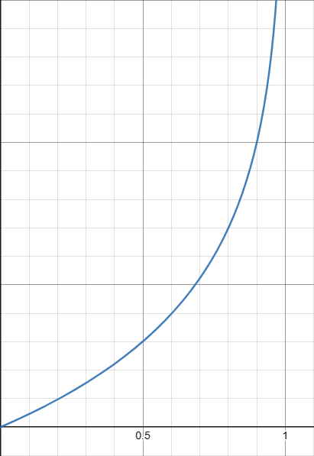
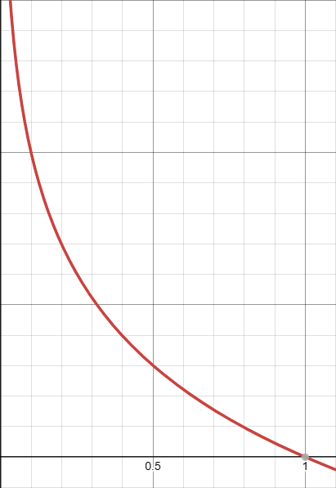
Logistic Regression
A new cost function…
Notes:
which represents the loss for a prediction of 1, is extremely large near 0 and tails of to 0 as the predicted value approaches 1, while the opposite happens for this part of the function **(slide)**

Slide 91
Logistic Regression
A new cost function…
Notes:
which represents the loss for a prediction of 0.
Now let’s look at the two parts together. Remember that the first part tells you the error when the model is supposed to predict 1. When the predicted value approaches 1, the second part of the function here **(point)** will be eliminated since the coefficient becomes 1 – 1 = 0. Similarly, when we’re supposed to predict 0, we see that this first term will then be eliminated. In that sense, evaluating this whole cost function each time we calculate error, we’re automatically “choosing” the correct loss function to use based on what prediction output we’re supposed to get. **(slide)**

Slide 92
But what if we have more than two classes for output?
Notes:
Of course, we can also extend logistic regression a bit further than simple binary classification as well. **(slide)**

Slide 93
Multi-class classification
White
Red
Champagne
Notes:
Say we wanted to introduce a third type of wine, such as champagnes. How would we use this binary classifier to classify three types of wines? Indeed, there are two main ways that we can do this: **(slide)**

Slide 94
One vs. One and One vs. All Classification
Notes:
one-vs-one and one-vs-all classification. **(slide)**

Slide 95
One vs. One Classification
Notes:
In one-vs-one classification, we take all of the possible classes and pair them up with each other. Since we have 3 possible classes here, we make the three possible pairs: **(slide)**

Slide 96
One vs. One Classification
White
Red
Notes:
white vs. red, **(slide)**

Slide 97
One vs. One Classification
White
White
Red
Champagne
Notes:
white vs. champagne, and **(slide)**

Slide 98
One vs. One Classification
White
White
Red
Red
Champagne
Champagne
Notes:
red vs. champagne. We can then make a binary classifier for each of these three pairs, **(slide)**

Slide 99

One vs. One Classification
more pairs
voted for white!
White
White
Red
Red
Champagne
Champagne
It’s white!
One-vs-one multiclass classification uses the most “voted for” class among paired models
Notes:
and have the pairs "vote" on which type of wine it is. The class with the most votes, in this case the white wine, is the class that the model predicts. However, there exists a fundamental issue with one-vs-one classification, which is present in this third pair's comparison.
DEMO: have 3 people volunteer and play rock-paper-scissors against each other, and explain the same concept of “most votes wins”.
**(slide)**

Slide 100
Problems with One vs. One Classification
Red
is that really red?
Champagne
Notes:
Say we have a white wine as before, and we plug it into the red/champagne classifier. If we get a value in the middle here, can we really call it a red wine? We’re essentially forcing a square peg into a round hole and labelling a datapoint with two labels that don’t describe it at all. This is one of the reasons behind why one-vs-all (sometimes known as one-vs-rest) classification also exists. In one-vs-all classification, **(slide)**

Slide 101
One vs. All Classification
White
Red
Champagne
Not white
Not red
Not champagne
pick the answer with highest probability
Notes:
When we go through all of the classifiers, we then pick the one with the **(click)** highest probability.

Slide 102
A quick summary…
Notes:
So **(click)** to summarise…

Slide 103
what is Artificial Intelligence?
input
Model
output
Notes:
…when we talk about AI, we’re talking about a model that takes a certain dataset of inputs and provides you with a certain kind of output that it isn’t explicitly coded to do. **(slide)**

Slide 104
Supervised Learning
Linear Regression
Logistic Regression
Polynomial Regression
Notes:
We have a lot of different models that we can use: for example, supervised learning, which we talked about today. Remember that supervised learning uses prepared and labelled data in order to build a model that can take in similar, unlabelled data and make accurate predictions.
Within this umbrella of supervised learning, we talked about regression and classification predictors, which make continuous and categorical/discrete predictions respectively. In particular, the three models are linear (point) and polynomial (point) regressions, which are themselves regression models, as well as logistic regression (point) which is a classifier model. (click)

Slide 105
Lab time!
Notes:
Let’s take 10 minutes quickly, then we’ll get onto the lab!

